Slide 2
BIBLE TRIVIA…

Slide 3
How many books are there in the Bible?

Slide 4
66

Slide 5
In Psalm 51, David prayed, “Lord, create in me a _________ heart.”

Slide 6
CLEAN

Slide 7
In Galatians 6, Paul writes, “You will reap what you __________”

Slide 8
SOW

Slide 9
On what day of the week was Jesus crucified?

Slide 10
FRIDAY

Slide 11
What holiday commemorates this world-changing event?

Slide 12
GOOD FRIDAY

Slide 13
Who became king of Israel after King Saul died in battle, along with his sons?

Slide 14
DAVID

Slide 15
Name FOUR disciples of Jesus

Slide 16
PETER, JAMES (2x), JOHN, ANDREW, THOMAS, MATTHEW, JUDAS (2x), PHILIP, SIMON, BARTHOLOMEW

Slide 17
On the night Jesus was arrested, who denied that he even knew Jesus THREE times?

Slide 18
PETER

Slide 19
Quote John 3:16?

Slide 20
For God so loved the world that He gave His one and only Son so that whoever believes in Him will not perish but have everlasting life.

Slide 21
In what book of the Bible would you find John’s prophecy about the end of the world?

Slide 22
REVELATION

Slide 23
What king first built
the temple of the Lord
in Jerusalem?

Slide 24
KING SOLOMON

Slide 25
What form did the devil take to trick Eve into eating fruit from the forbidden tree?

Slide 26
A SERPANT

Slide 27
Who is your favorite youth leader of all time?

Slide 28
IF YOU DON’T SAY ME, YOU ARE IN TROUBLE!!

Slide 31
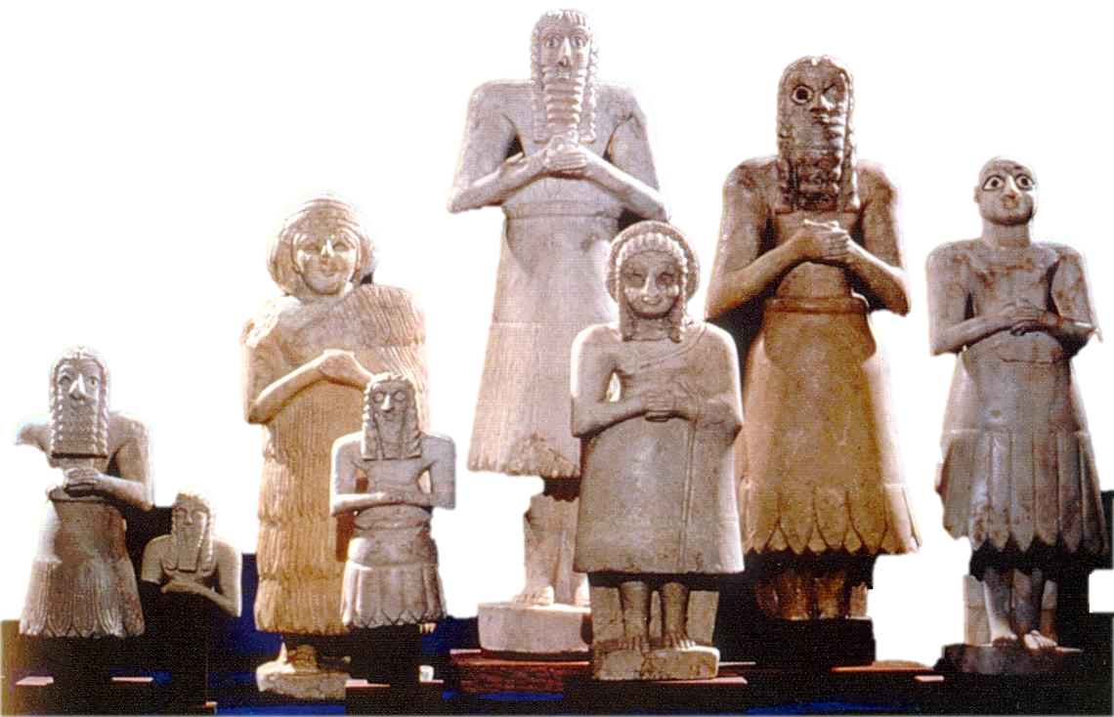

Slide 32
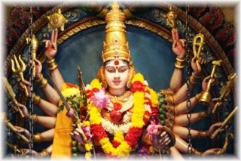

Slide 33
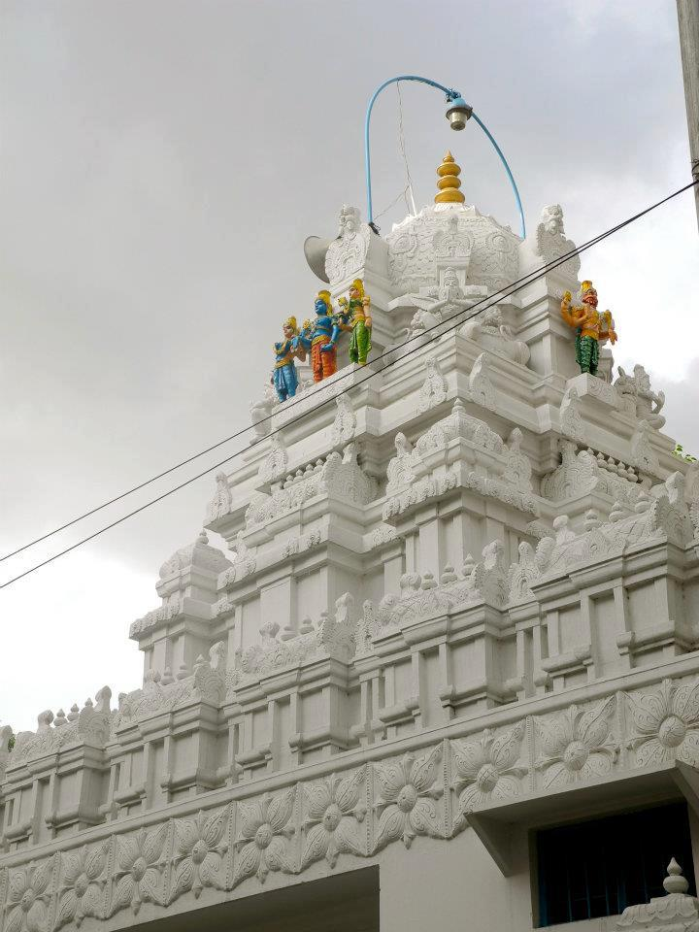

Slide 34
An idol is anything that seeks to take
God out of first place in your heart.

Slide 35
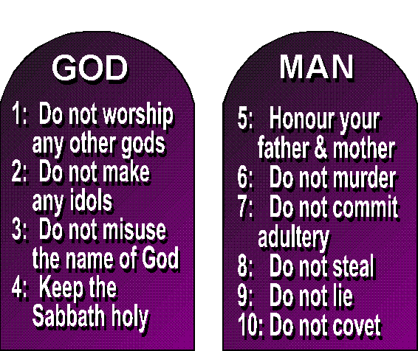

Slide 36
Guard your heart
above all else, for it determines the course of your life.
~ Prov. 4:23

Slide 38
god (idol)

Slide 39
Let the Spirit renew your thoughts and attitudes. Put on your new nature, created to be like God—truly righteous and holy.
~ Ephesians 4:23,24

Slide 40
Renew = in the middle of something new
“Let the Spirit put your thoughts in the middle of something new…”

Slide 41
Don’t copy the behavior and customs of this world, but let God transform you into a new person by changing the way you think. ~ Romans 12:2

Slide 42
Changing = putting on something new and fresh
“Let God transform your thoughts by making them new and fresh.”

Slide 43
Pleasure

Slide 44
Think about the things of heaven, not the things of earth. Because you have died to this life and now live for Christ.
~ Colossians 3:2,3

Slide 45
Think = be conceited
What does a conceited person think about?

Slide 46
Be conceited about heaven– only think about heaven, not the stuff of earth.

Slide 47
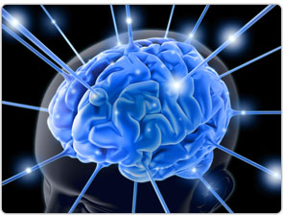
My pleasure
Make me happy
Make
me
Feel good
Give me what I want
Live for me
Do what I want

Slide 48
GOD
GOD
GOD
GOD
GOD
GOD
GOD
GOD
GOD
GOD
GOD
GOD
GOD
GOD

Slide 49
“I’M BORED!!!”

Slide 50
Since 1988, use of antidepressants in the U.S. has gone up 400%.
Now 1 in 6 Americans over age 12 take them.

Slide 51
God, You will show me the way of life, granting me the joy of your presence and the pleasures of living with You forever.
~ Psalm 16:11

