Slide 3
People who suffer from Automatonophobia are afraid of what?
1)
A. Cars
B. Ventriloquist's dummies
C. Assembly Lines
D. Singing out of tune

Slide 4
People who suffer from Automatonophobia are afraid of what?
1)
B. Ventriloquist's dummies

Slide 5
If you don’t go out at night because you are afraid of the moon you suffer from what?
2)
A. Lunaphobia
B. Phasiphobia
C. Agrizoophobia
D. Selenophobia

Slide 6
If you don’t go out at night because you are afraid of the moon you suffer from what?
2)
D. Selenophobia

Slide 7
It might be embarrassing to go to school if you suffer from Vestiphobia because it is a fear of…
3)
A. Clothing
B. Brushing your teeth
C. Bathing
D. Lunchrooms

Slide 8
It might be embarrassing to go to school if you suffer from Vestiphobia because it is a fear of…
3)
A. Clothing

Slide 9
What are people who have Apotemnophobia afraid of?
4)
A. Cheese
B. Medicine
C. Amputees
D. The Sun

Slide 10
What are people who have Apotemnophobia afraid of?
4)
C. Amputees

Slide 11
If you have Methyphobia what place would you most likely want to avoid?
5)
A. Church
B. A Bar
C. An Elementary School
D. A Crack House

Slide 12
If you have Methyphobia what place would you most likely want to avoid?
5)
B. A Bar
(Methyphobia is a fear of alcohol)

Slide 13
If suffer from Ornithophobia what movie would scare you the most?
6)
A. Killer Clowns from Outer Space
B. Cujo
C. The Birds
D. Attack of the Killer Tomatoes

Slide 14
If suffer from Ornithophobia what movie would scare you the most?
6)
C. The Birds

Slide 15
A fear of animals is sometimes referred to as…
7)
A. Zoophobia
B. Mamalianphobia
C. Criterphobia
D. Speciaphobia

Slide 16
A fear of animals is sometimes referred to as…
7)
A. Zoophobia

Slide 17
Erytophobia is the fear of…
8)
A. Wide Open Spaces
B. Koala Bears
C. T.V. Screens
D. Red Lights

Slide 18
Erytophobia is the fear of…
8)
D. Red Lights

Slide 19
If you have an abnormal fear of Friday the 13th you most likely suffer from…
9)
A. Vorhesianphobia
B. Tredecimaphobia
C. Paraskavedekatriaphobia
D. Scarymoviephobia

Slide 20
If you have an abnormal fear of Friday the 13th you most likely suffer from…
9)
C. Paraskavedekatriaphobia

Slide 21
If you are dating someone who has Agoraphobia which of these would be a bad choice for a date?
10)
A. Watching a rented movie at home
B. Going to a football game
C. A private candlelight dinner
D. Playing cards with your friends

Slide 22
If you are dating someone who has Agoraphobia which of these would be a bad choice for a date?
10)
B. Going to a football game
(Agoraphobia is a fear of open spaces and crowds)

Slide 23
Didaskaleinophobia is a fear that many people get at the end of summer. What is it a fear of?
A. Indian Summer
B. Harvests
C. Falling Leaves
D. School

Slide 24
Didaskaleinophobia is a fear that many people get at the end of summer. What is it a fear of?
D. School

Slide 27
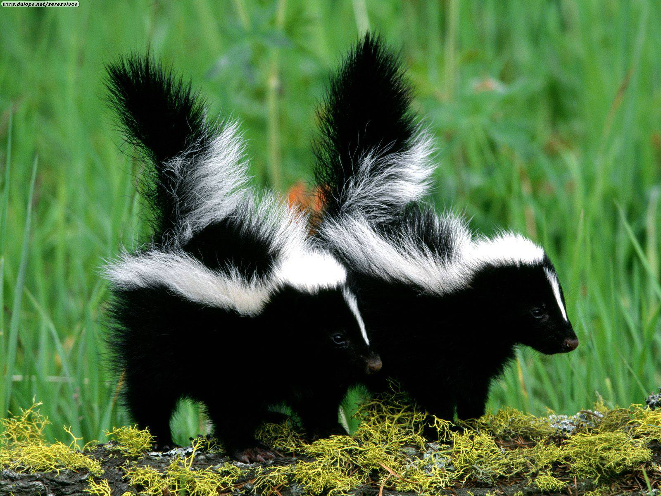

Slide 28
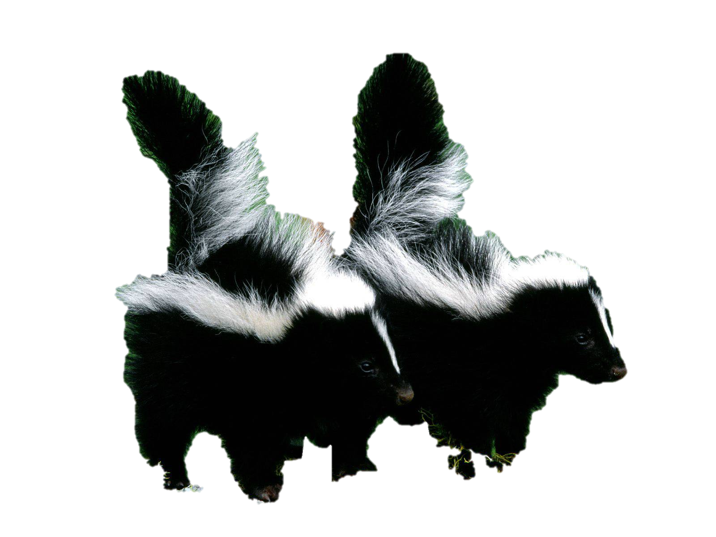
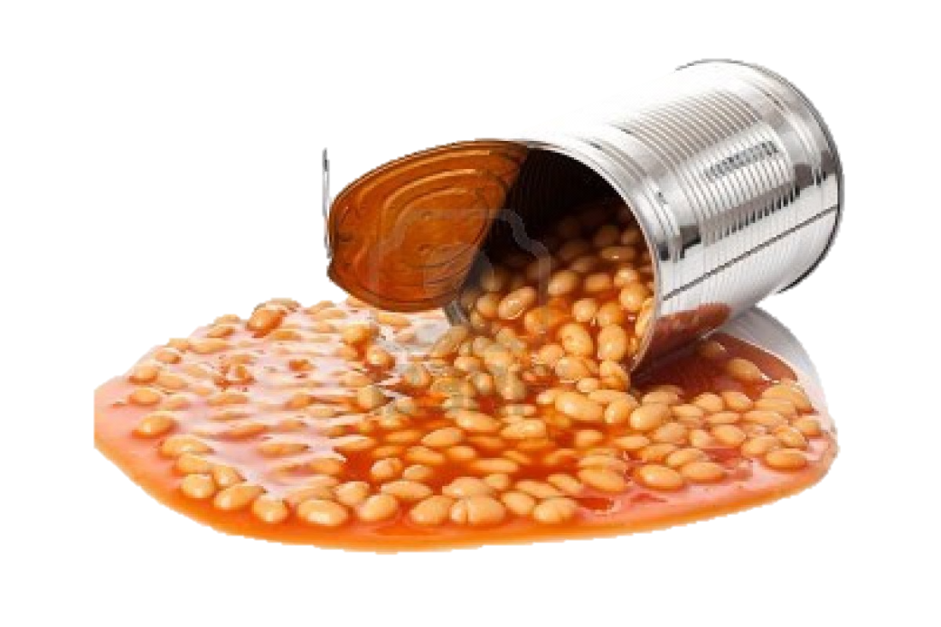

Slide 30
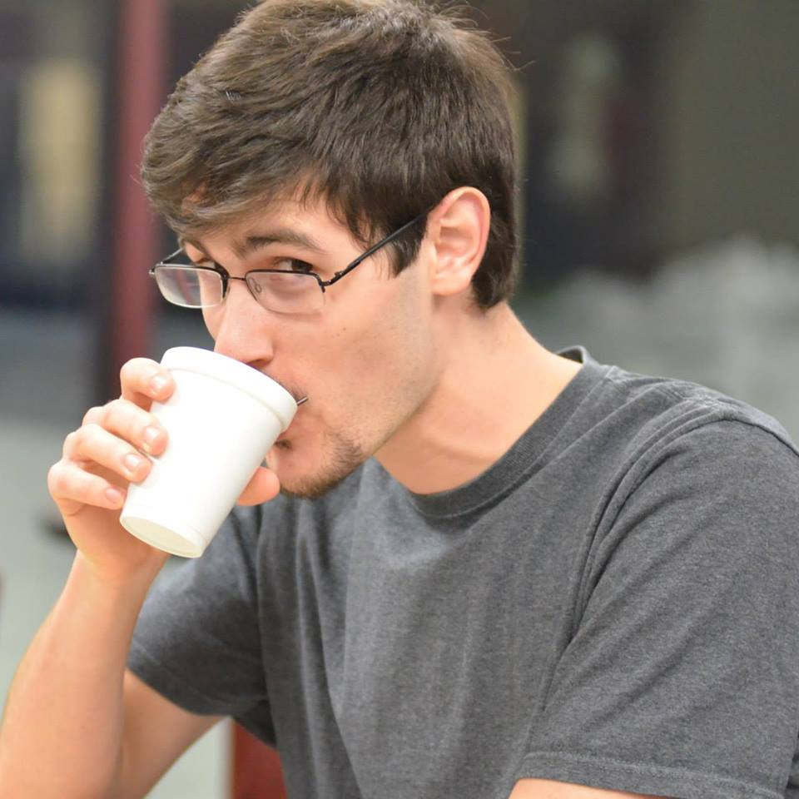
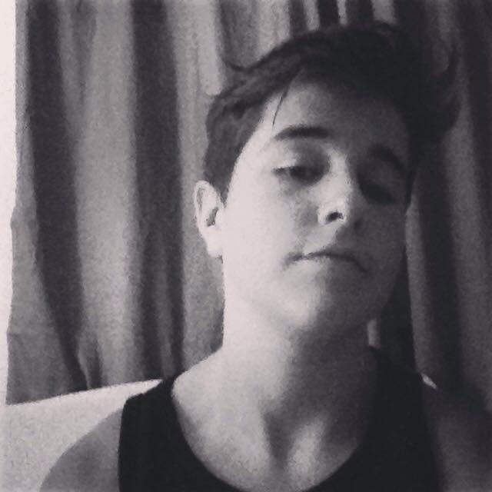

Slide 31
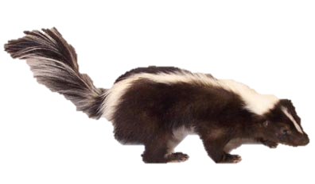

Slide 32
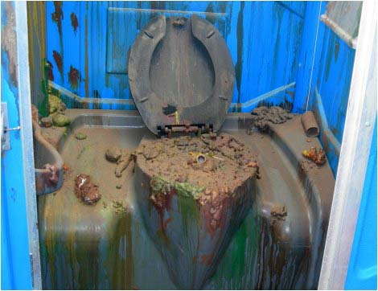

Slide 33
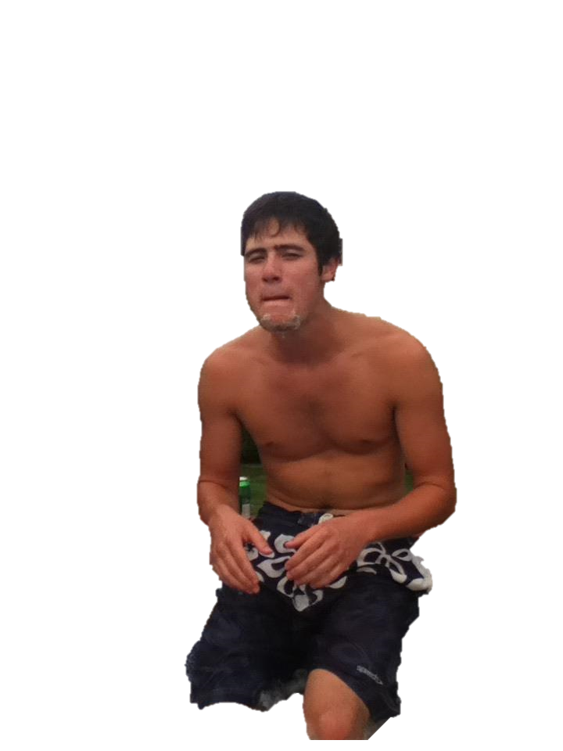

Slide 36
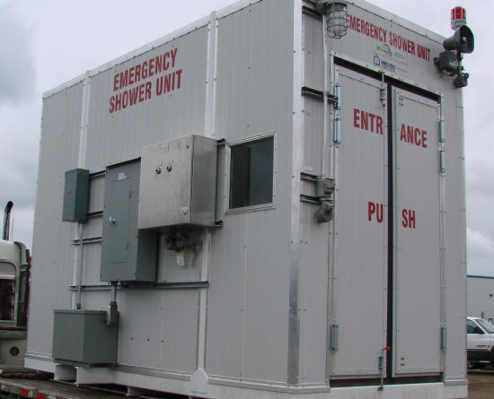

Slide 37
DRUGS
ALCOHOL

Slide 39
PEOPLE
EMOTIONS
FEARS
INFLUENCES
LANGUAGE

Slide 40
LANGUAGE

Slide 41
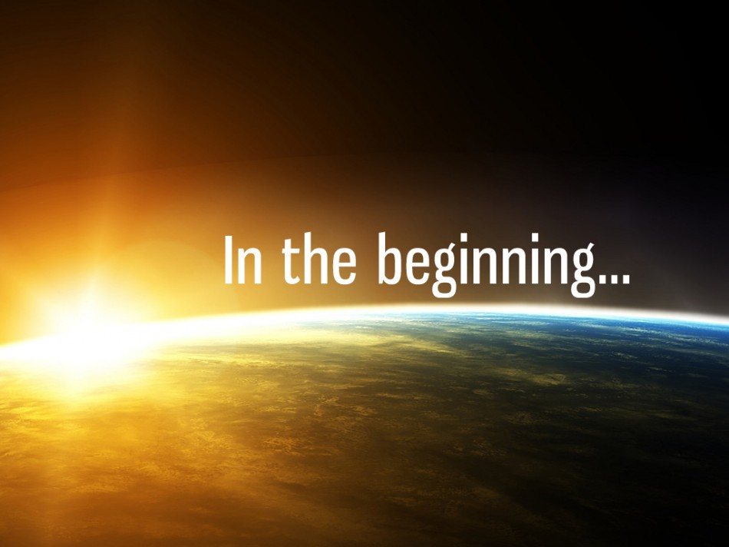
Words are powerful things. It was with just words that God created the entire universe. We are made in God’s image, that means our words also have power…to bless, to curse, to heal, to hurt

Slide 42
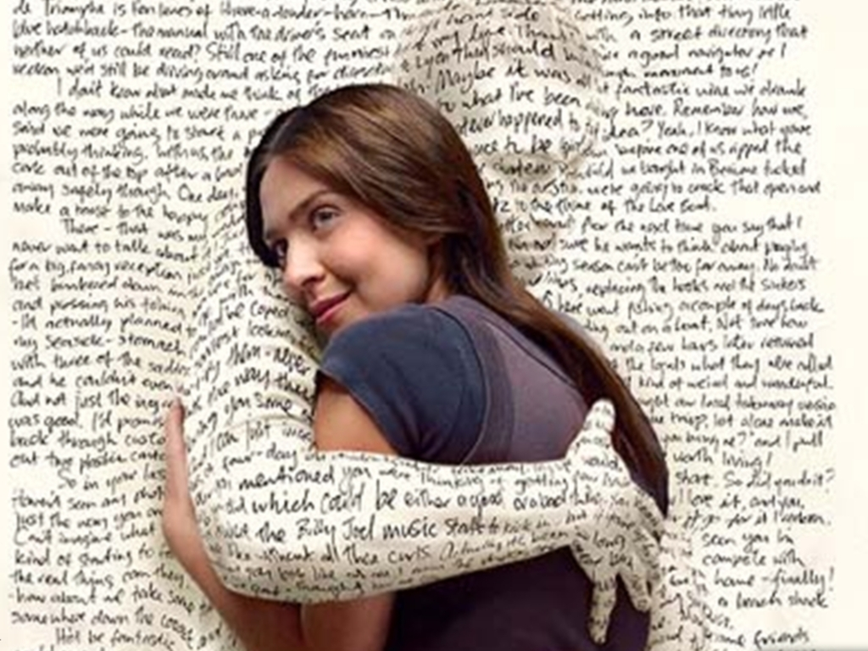

Slide 43
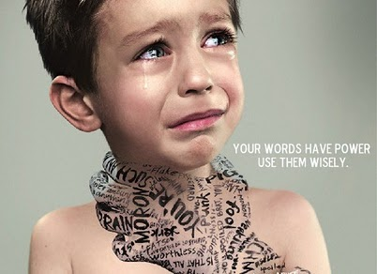
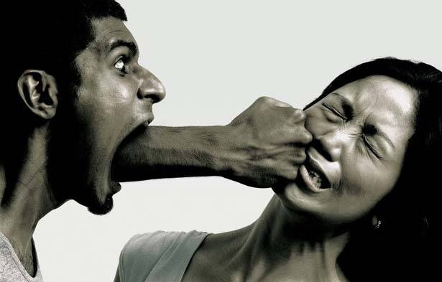

Slide 44
Death and life are
in the power
of the tongue, and those who love it will eat its fruit.
~ Proverbs 18:21

Slide 45
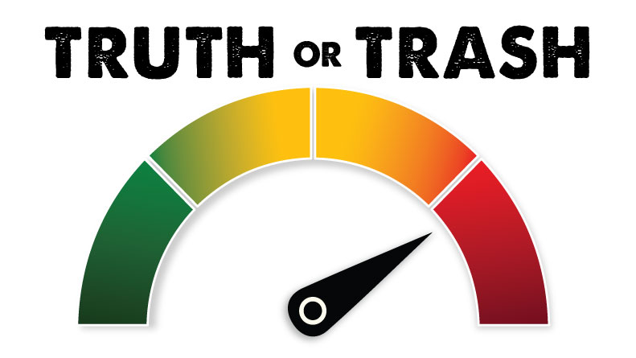

Slide 46
Character
formation formula
What you put into your heart/mind is what you THINK about
What you THINK about is what you DO
What you DO becomes your BEHAVIOR
Your BEHAVIOR becomes your CHARACTER
And your CHARACTER is who YOU ARE

