Slide 1


Slide 2
LET’S PLAY
What’s Wrong with This Ad???

Slide 16

LiES
THE CULTURE
TELLS ME

Slide 17

YOU DON’T
NEED JESUS

Slide 18
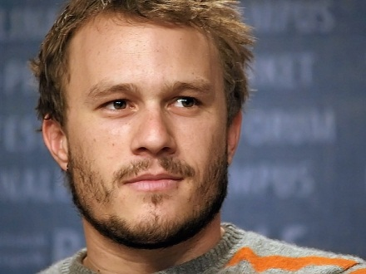

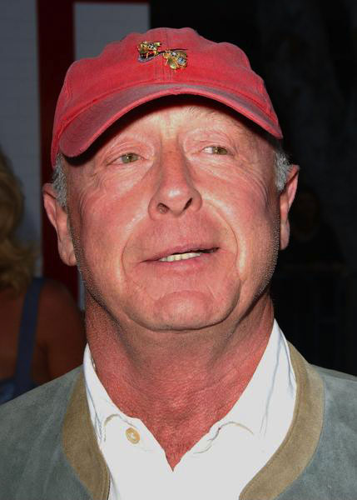
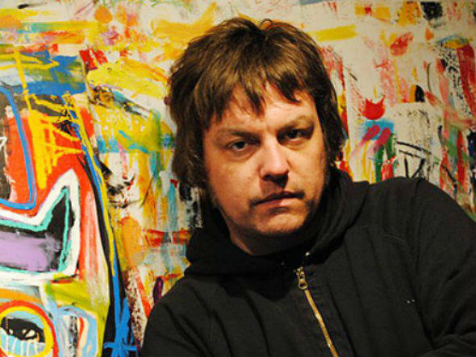


Slide 19

THERE IS A GOD-SIZED HOLE
IN EACH PERSON’S HEART

Slide 20
May you experience the love of Christ, though it is so great you will never fully understand it. Then you will be filled with the fullness of life and power that comes from God.
` Ephesians 3:19

Slide 21
Follow Your Heart

Slide 22


Slide 23


Slide 24
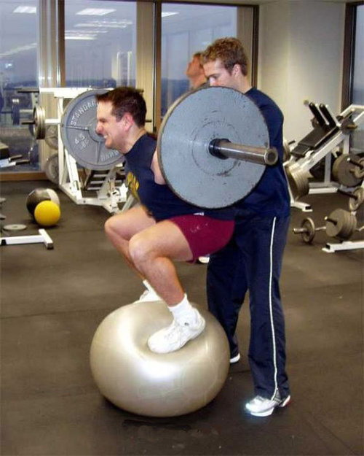

Slide 25
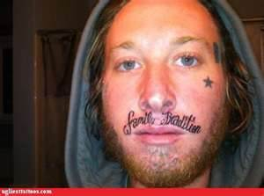

Slide 26
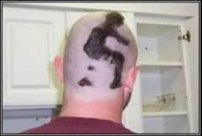

Slide 27
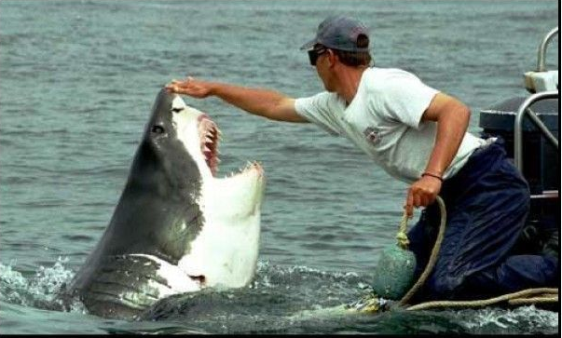

Slide 28
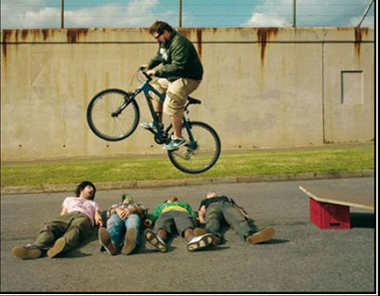

Slide 29
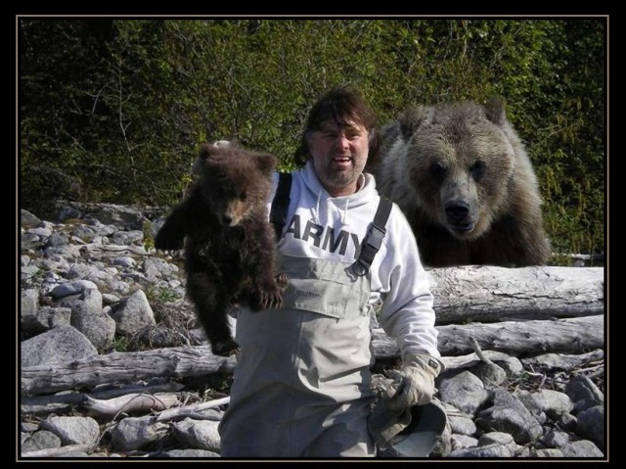

Slide 30
Follow Your Heart

Slide 31







Slide 32
“And when you are unsure, just always
follow your heart.”
~ Terminator Salvation
“Just follow the star in your own heart.” ~ Home Alone 2

Slide 33
“Always follow your heart.” ~ The Fall
“And follow your heart.”
~ The Golden Child
“Follow your heart.”
~ Imagine Me and You

Slide 34
“Follow your heart.”
~ Spirit: Stallion of Cimarron
“Be true to yourself and follow your heart.” ~ Raise Your Voice
“Follow your heart and don’t question it.” ~ Mini’s First Time

Slide 35
“Just try, and follow your heart. I mean, isn’t that what all the great leaders do? ~ Roswell
“Just follow your heart, and go as far as your dreams.” ~ Cinderella 2

Slide 36
“I wish I could tell you what to do, but, I can't. All I can say is, follow your heart. It'll tell you what's right.” ~ Lizzie McGuire
“If there's one thing to learn it's you just can't go wrong if you follow your heart…”
~ Ella Enchanted

Slide 37
“The human heart is most deceitful and desperately wicked. Who really knows how bad it is?” ~ GOD (Jeremiah 17:9)
“For from the heart come evil thoughts, murder, adultery, all other sexual immorality, theft, lying, and slander.”
~ JESUS (Matthew 15:19)

Slide 38
As the Scriptures say, "No one is good -- not even one. No one has real understanding; no one is seeking God. All have turned away from God; all have gone wrong. No one does good, not even one--Their talk is foul, like the stench from an open grave. Their speech is filled with lies. The poison of a deadly snake drips from their lips. Their mouths are full of cursing and bitterness. They are quick to commit murder. Wherever they go, destruction and misery follow them. They do not know what true peace is. They have no fear of God to restrain them."
~ Romans 3:10-18

Slide 39


Slide 40


Slide 41
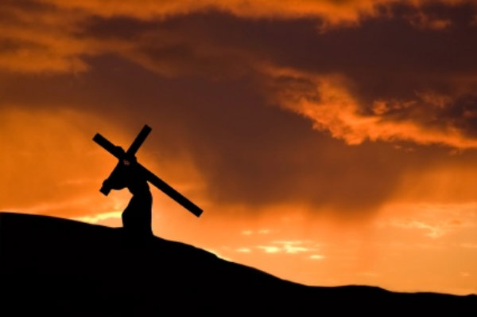
FOLLOW
CHRIST
ALONE

