Slide 2
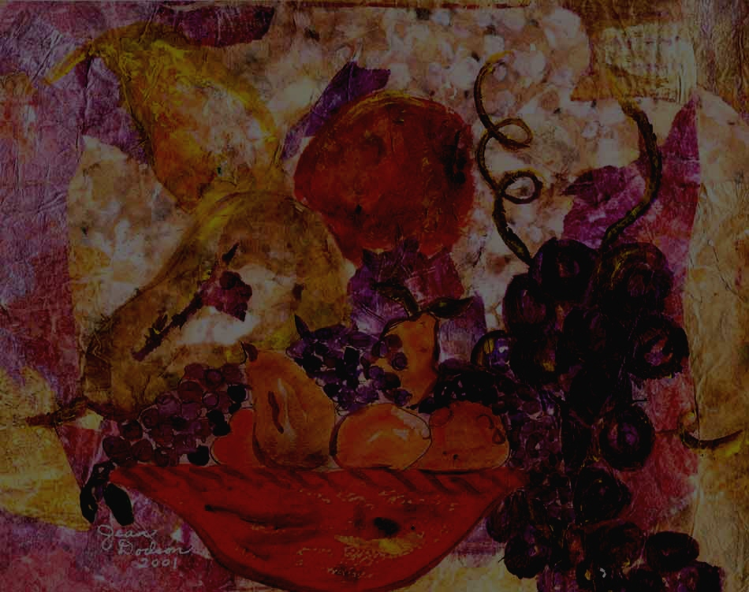
Know Your Fruit

Slide 3
Know Your Fruit
Lime
Kiwi
Honeydew

Slide 4
Know Your Fruit
Lime
kiwi
Honeydew

Slide 5
Know Your Fruit
Papaya
Cantaloupe
Squash

Slide 6
Know Your Fruit
Papaya
Cantaloupe
Squash

Slide 7
Know Your Fruit
Unripened coconut
Spanish pumpkin
Guava

Slide 8
Know Your Fruit
Unripened coconut
Spanish pumpkin
Guava

Slide 9
Know Your Fruit
Equatorial plum
Tropical prune
Passion fruit

Slide 10
Know Your Fruit
Equatorial plum
Tropical prune
Passion fruit

Slide 11
Know Your Fruit
Durian
Armadillo fruit
thornberry

Slide 12
Know Your Fruit
Durian
Armadillo fruit
thornberry

Slide 13
Know Your Fruit
Bo-bo
Pome-granates
Ackee

Slide 14
Know Your Fruit
Bo-bo
Pome-granates
Ackee

Slide 15
Know Your Fruit
Cacao
Brown avocado
Thai figs

Slide 16
Know Your Fruit
Cacao
Brown avocado
Thai figs

Slide 17
Know Your Fruit
Dragon fruit
Burning bush
Del fuego

Slide 18
Know Your Fruit
Dragon fruit
Burning bush
Del fuego

Slide 20
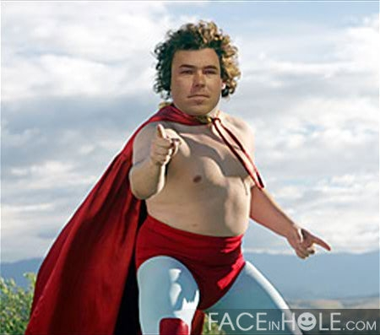
NACHO LEE-BRE

Slide 21
49
3

Slide 22
YANKEES LOSE 75th in a ROW

Slide 23
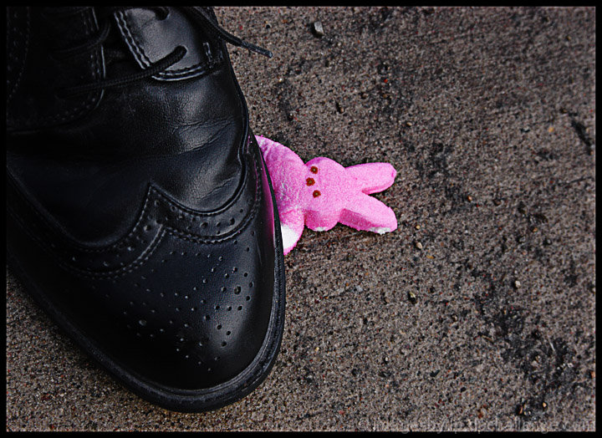

Slide 24
GOD WANTS ME TO BE HAPPY

Slide 25
For a time is coming when people will no longer listen to sound and wholesome teaching. They will follow their own desires and will look for teachers who will tell them whatever their itching ears want to hear. They will reject the truth and chase after myths.
~ 2 Timothy 4:3,4 (NLT)

Slide 26
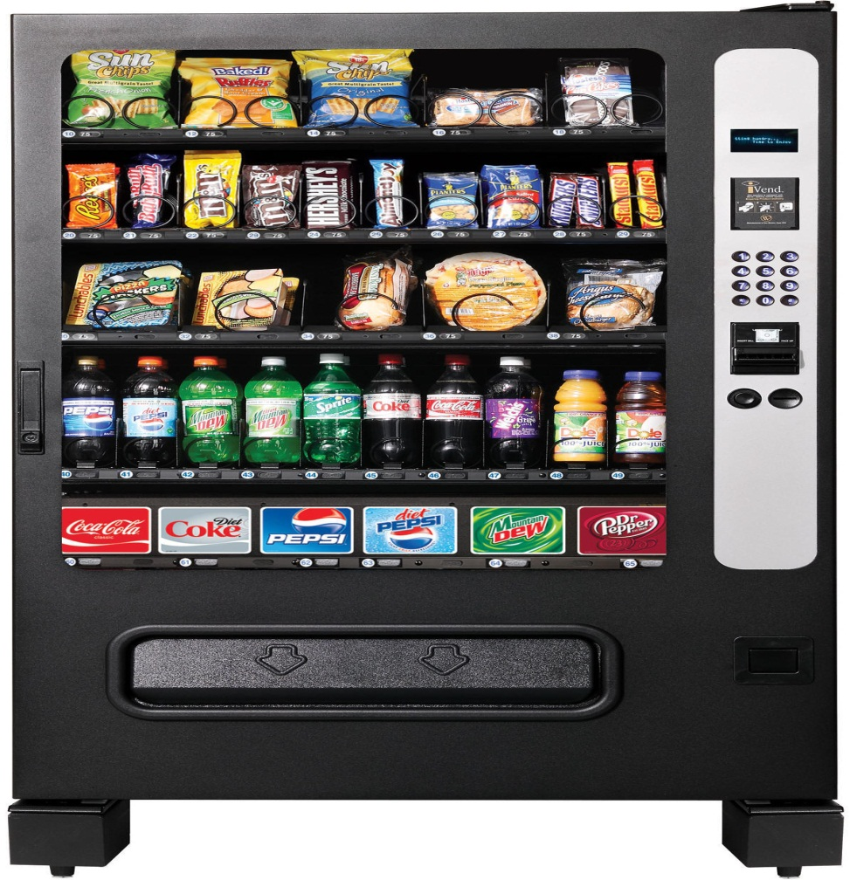

Slide 27
GOD DOESN’T WANT YOU HAPPY WHEN IT CAUSES YOU TO SIN.

Slide 28
But now you must be holy in everything you do, just as God who chose you is holy. For the Scriptures say, “You must be holy because I am holy.”
~ 1 Peter 1:15,16 (NLT)

Slide 29
GOD DOESN’T WANT YOU HAPPY WHEN IT IS DRIVEN BY PEOPLE, THINGS, AND
CIRCUM STANCES.

Slide 30
FIRST KEY TO SPIRITUAL SUCCESS
Exchange temporary happiness for lasting joy

Slide 31
Because of the joy awaiting him, Jesus endured the cross, disregarding its shame. Now he is seated in the place of honor beside God’s throne. ~ Hebrews 12:2b (NLT)

Slide 32
But I will rejoice even if I lose my life, pouring it out like a liquid offering to God, just like your faithful service is an offering to God. And I want all of you to share that joy.
~ Philippians 2:17 (NLT)

Slide 33
Whatever happens, my dear brothers and sisters, rejoice in the Lord. I never get tired of telling you these things, and I do it to safeguard your faith.
~ Philippians 3:1 (NLT)

Slide 34
Always be full of joy in the Lord. I say it again—rejoice! ~ Philippians 4:4 (NLT)

Slide 35
THE KEY TO A FULFILLED LIFE IS NOT FOUND IN BOUNCING FROM TEMPORARY HAPPINESS TO TEMPORARY HAPPINESS. THE SECRET TO LIFE IS FOUND IN CHRIST WHO PROVIDES A JOY THAT IS NOT SUBJECT TO PEOPLE, THINGS, OR CIRCUMSTANCES

Slide 36
SECOND KEY TO SPIRITUAL SUCCESS
Understand that lasting joy is found in Christ

Slide 37
I know how to live on almost nothing or with everything. I have learned the secret of living in every situation, whether it is with a full stomach or empty, with plenty or little. For I can do everything through Christ, who gives me strength. ~ Philippians 4:12-13 (NLT)

Slide 38
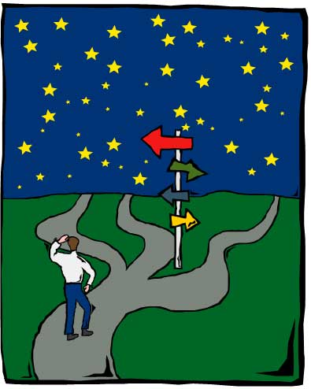
Unbelief
Pleasure
Money
Fame
Position

Slide 39
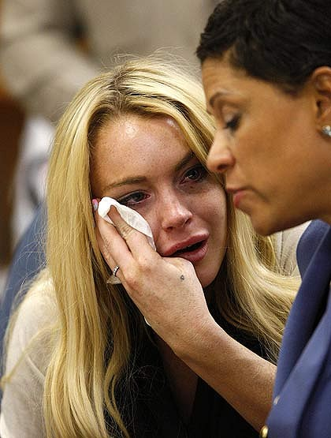
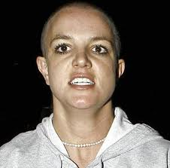
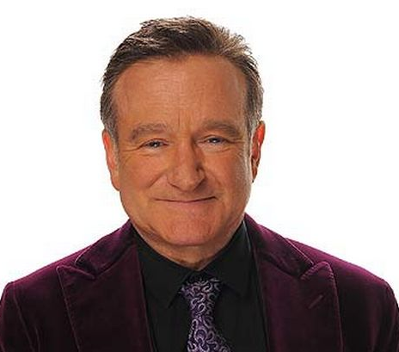
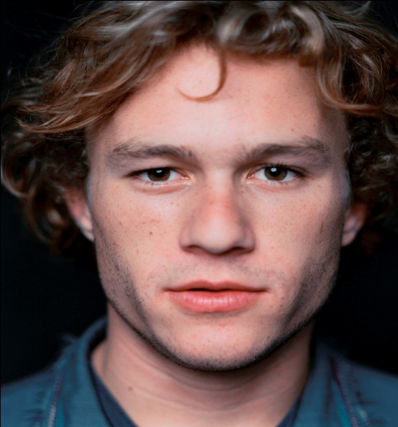

Slide 40
“Don’t be dejected and sad, for the joy of the Lord is your strength!”
~ Nehemiah 8:10b (NLT)

Slide 41
Are you pursuing happiness more
than you are
pursuing Christ?

